Slide 1
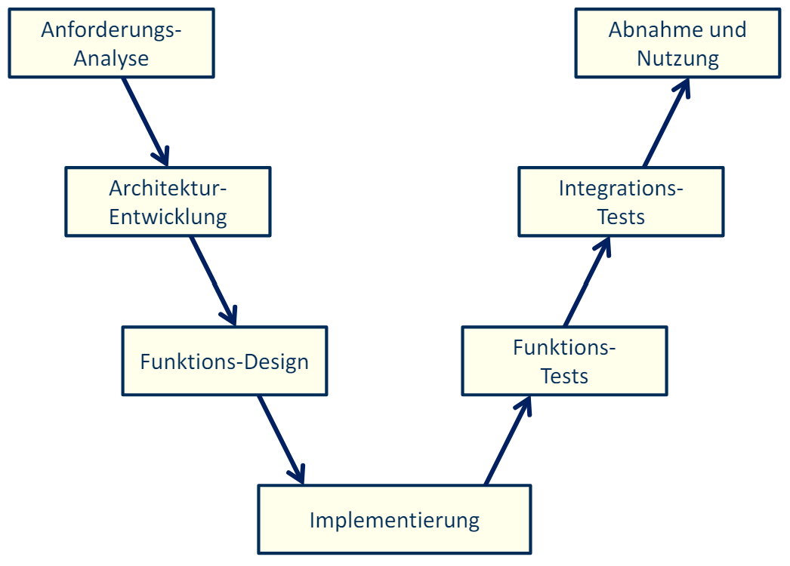
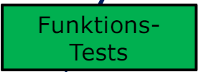
BMSLAB – function testing
Hochschule Esslingen
FZM, SS2024
Dominik Fruehm, Aron Gervalla, Stefan Ljubisavljevic, Niklas Gerald Schlosser, Diana Wacker, Jan Wendler

Slide 2
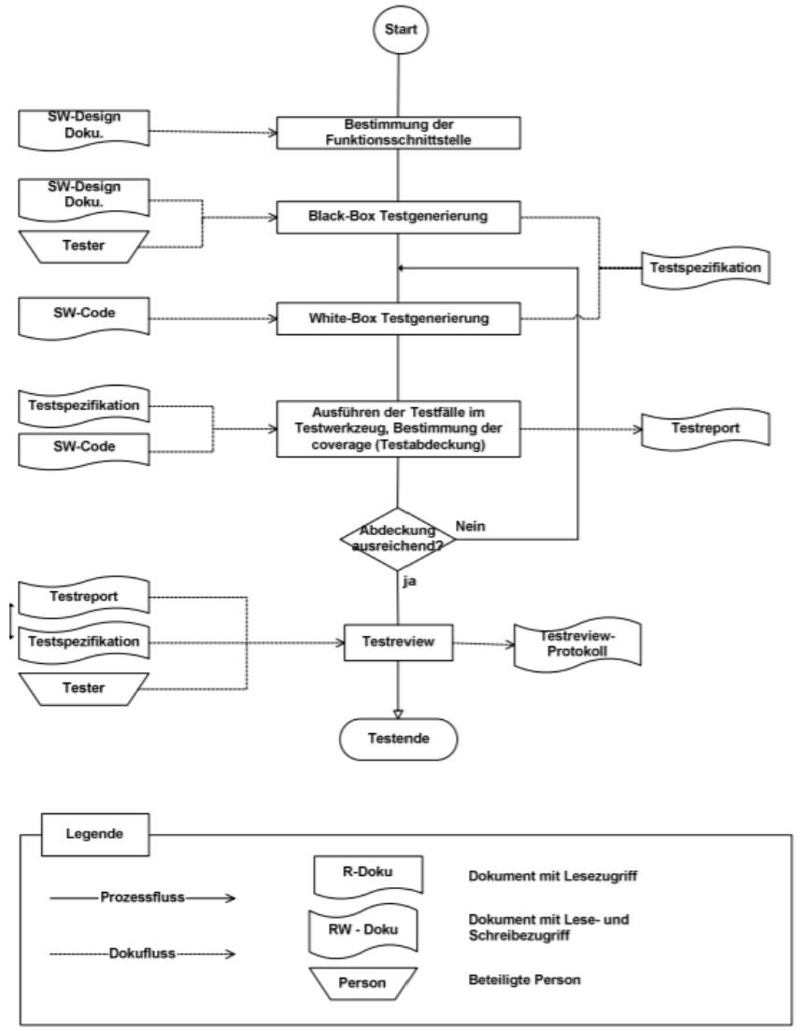

Slide 3
Inhalt
1 | Cell-Balancing | 4
2 | Cell-Voltage | 5
3 | Over Temp | 6
4 | Upper Display | 7
5 | Lower Display | 8
6 | Safety Control | 9

Slide 4
1 Cell-Balancing

Slide 5
2 Cell-Voltage

Slide 6
3 Over Temp

Slide 7
4 Upper Display

Slide 8
5 Lower Display

Slide 9
6 Safety Control

